Slide 1

Deployment Bootcamp
BJSS Limited
If a tree falls when nobody watches, does it make a sound?
George Berkeley
Notes:
If we don't deploy our latest features, will anybody care?

Slide 2

Tutor Intro: Alan Mellor
Alan Mellor – BJSS Consultancy ltd
Programming since 1981
Instructor at BJSS Manchester Academy
Write at www.viewfromthecodeface.com, Quora

Slide 3

Tutor Intro: Alex Bramham
Alex Bramham – BJSS Consultancy ltd
Full Stack Engineer
Java, Groovy, SQL, Maven, Shell, AWS, Terraform...
Migrated CI cross-region to Jenkins pipelines used by 50+ devs
Fixed deadlocks in Jenkins open source code
Independent Android developer – apps downloaded by 100,000 users

Slide 4

Notes:
Generally no phones pleases
If you have to take a call – please feel free to do so, but be kind to others by taking it out of this room

Slide 5
Bootcamp Delivery
Divided into short tuition sections no more than a couple of hours
Emphasis on exercises rather than slides
Interactive
Lunch: 1 Hour
Notes:
We planned around 1 hour sessions, but run throughs mean we might go a little over in parts
We've worked hard to make some meaningful exercises for this.
Deployment technologies are really only five years old and there are a huge array of options.
We hope you'll enjoy the path we've picked through this maze
Feel free to ask questions whenever it seems sensible to do so.

Slide 6

Please Be Punctual
It’s polite, it’s professional
Waiting wouldn’t be fair on others
Notes:
Please come back on time after breaks!

Slide 7

Agenda
DAY 1
How did we get to CI / CD ?
The concept of ‘Shift Left’
Modern CI / CD Platforms
Jenkins
Packaging and Dependencies
Test Automation
DAY 2
Packaging
Deployment
Monitoring and Metrics
Scaling Up
Cloud Computing
Infrastructure
Notes:
Quick agenda read through

Slide 8
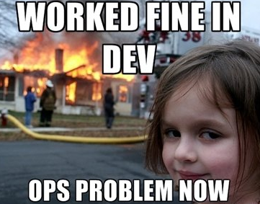
Once:
An after-thought
Now:
Most important part of development
No deployment:
No users
No money
Notes:
Deployment used to be an after-thought. Developers would do their thing, check some code in - then they were done. But if nobody can ever use your code, none of your development was worth anything. About our quote on the title slide. → It's like the tree falling in the forest. Nobody is there, so nobody cares.

Slide 9
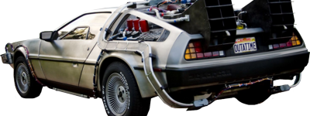
CI/CD – How did we get here? TC 8
Notes:
SHAPE OF SECTION
Few computers + Few users + Small, Fixed code
=> Many computers + Many users + Large, changing code
It's 2019 and things have completely changed. Most of you will work at places using CI/CD - Continuous Integration with Continuous deployment. DevOps is now a recognised discipline. So let's kick off by a quick history lesson: how did deployment get so complicated? How was code deployed in the past? - and why did we have to change?

Slide 10

Physical Wires
1940s
Code as wiring
Notes:
In the very earliest computers, code was stored as patterns of wires.
Programming was deployment!
You are looking at a 1948 ENIAC computer in the US.
And you'll also notice that all the programmers were women in those days
(this seems to have swung way too far the other way at present, and all the Manchester tech companies are trying to fix this and encourage women into engineering)
Wires gave us two problems:
Hard to change
Hard to make a copy of on another computer
But when computers weigh 8 tons and cost millions, that's not a big problem.

Slide 11

Williams Tube
1950s
Code as storage
Notes:
The next big advanced solved the ‘hard to change’ of wires
This is a memory device that stores code as electrical charge.
Each dot you see represents a zero or a one.
And with the right electronics – it was easy to change between them.
Code was now easy to change.
It was still hard to copy though – you could not simply carry one of these tubes from one computer to another
The first suitable program memory was invented down the road at Manchester University by Freddie Williams and Tom Kilburn.
You can see a working replica at the science museum.

Slide 12
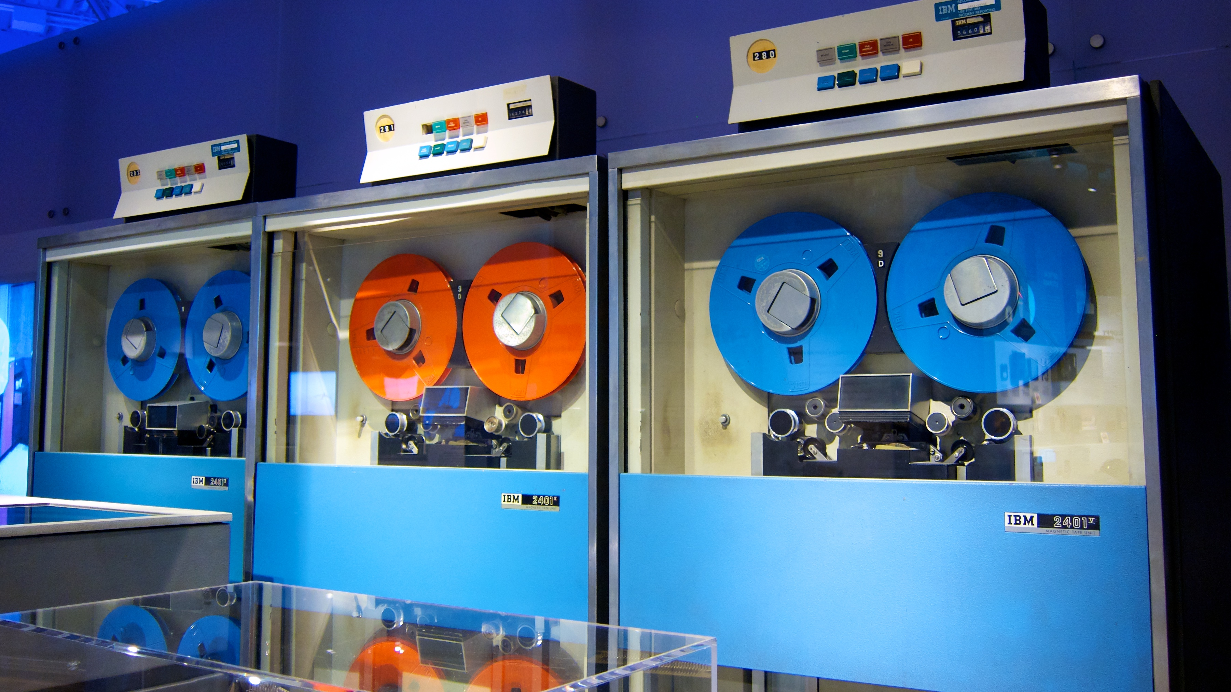
Magnetic Tape
1960s
Code as Magnetism
Notes:
We needed to solve this distribution problem.
Computing was getting used in more and more industries.
Software was getting bigger and more complex leading to code being written by external specialists.
The breakthrough cam by storing code on magnetic tape.
* Easy to change code – re-record the tape
* Easy to transport (well, if you had a van!)
But this was the start of being able to *ship* software between big companies

Slide 13
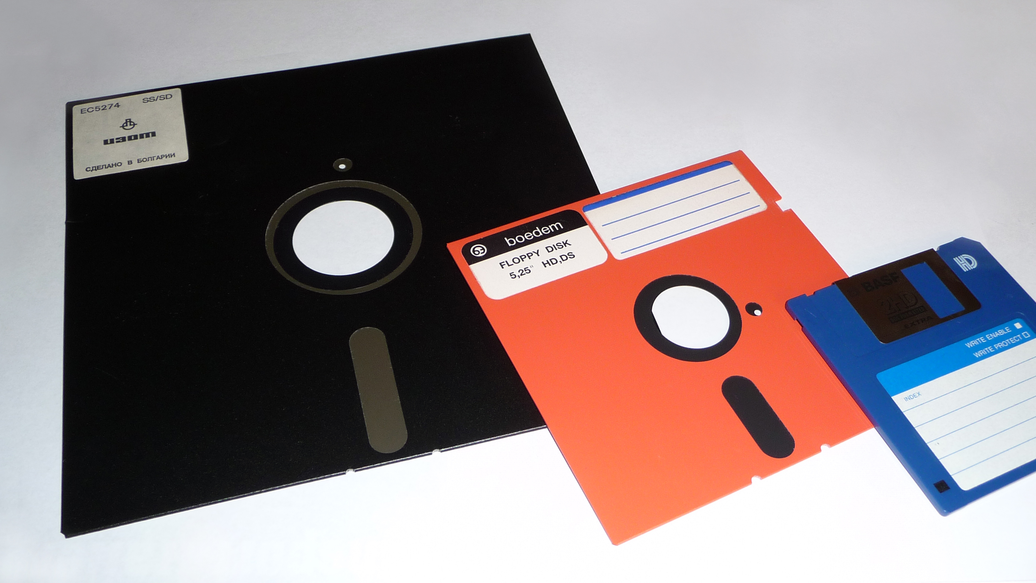
Floppy Discs
1980s
Cheaper, faster, better tapes
Notes:
The next big revolution was a small one - but economically massive.
If you shrink a magnetic tape into a round disk, you get a floppy disk.
They are cheaper, smaller, faster, hold more code.
Here's the huge leap:
* Put code on a disk
* Put the disk in a box
* Put marketing graphics on the outside
* Put these boxes in High Street stores
You have just caused an economic revolution in selling software to ordinary consumers – high volume, high margin profits.

Slide 14
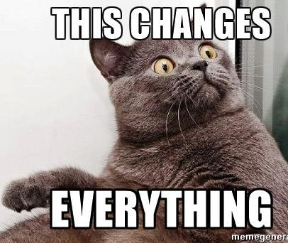
…..and especially software deployment.
A.M.A.: “What major reason people use the internet for that you were not expecting?”
Sir Tim Berners-Lee: "Kittens."
Notes:
Then … along came the WEB
And this meant *massive* changes in how software was consumed
We loved the "ask me anything" quote there in an interview with Sir Tim Berners Lee, the inventor of the web.

Slide 15
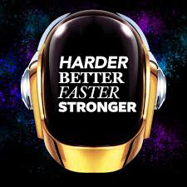
Notes:
The web brings huge challenges in delivering software
It's HARDER – we are delivering code to billions of users
It needs to be BETTER – users have high expectations and the attention spans of a goldfish
Delivery must be FASTER – Users won’t wait for updates and bugfixes anymore. They want them NOW!!!
Our process must be STRONGER – How can we ship stable, large scale software to billions of users – on time, every time?
If we ship low quality software, we pay an absolute fortune in first-line support costs and refunds.
[next slide will say 'we need a better process']
[ Extra point to everyone who got the Daft Punk reference ]

Slide 16

Shift Left The web brought about the need to do everything faster.
CI/CD shifts things earlier
Test automation finds bugs earlier
Build scripts box-up code earlier
Automated deployment gets code to users earlier
Monitoring and alerting reports faults earlier
Notes:
We NEED A BETTER PROCESS
We want to be sure the code is working sooner
We want to get features into users' hands sooner
We want to get bugfixes out sooner
Everything is 'sooner' - everything must happen earlier in the development process.
We call all this "SHIFT LEFT" - we improve delivery by making things happen earlier than they used to.
And it's finally good enough for the web and its billions of demanding users.

Slide 17

This is about Professional Engineering
It's one thing to write a prototype
It's another to ship quality on-time, every time
Notes:
AS AN ASIDE - This whole approach is about the difference between amateur and professional development.
* An amateur hopes for success
* A professional designs out failure
Modern CI/CD practices are there to ensure we rapidly deliver quality software to users.

Slide 18

Put lings cars here!
Notes:
One of my favourite 'deliberately amateur' looking websites is Ling's Cars –
as I'm sure everybody from AutoTrader is familiar with.
Ling is an absolute legend of a woman.
Do make sure you go to that home page and click 'View Source' - it's just brilliant.
But generally – the point of this slide – is that we want a professional process; not an amateur hacker one.

Slide 19

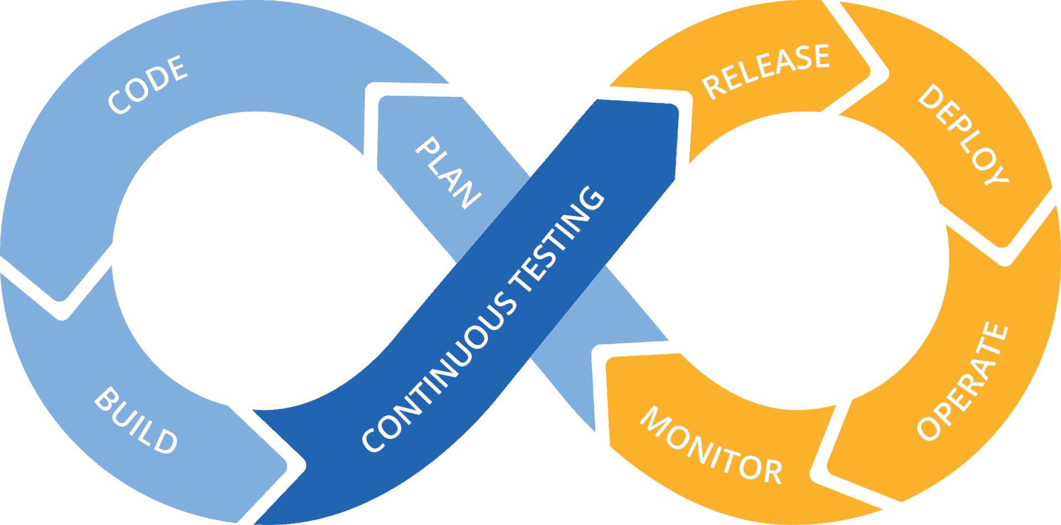
Agile: The Shift from Linear to Continuous TC9
Plan
Code
Test
Build
Release
Operate
Agile CI/CD fits modern users who always want more and want it now
We never stop developing
We never stop testing
We never stop deploying
Notes:
So what is this process?
As you know from previous bootcamps,
The solution is to use Agile development with a Continuous Integration / Continuous Delivery approach.
Instead of slow, waterfall and physical approaches, we continuously develop, test and deploy web software.
We have changed our process to fit the demands of our users

Slide 20
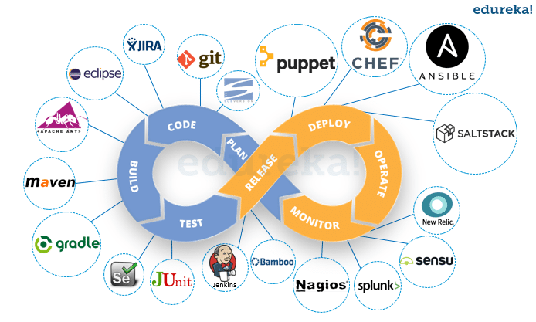
So Many Tools!
Explosion of tools available to use in every stage of your software preparation.
Very painful to run each individually in turn!
Slow to set up, slow to change
If only there was a way to link them all together, and run them automatically…..
Notes:
HOWEVER learning this stuff is not easy. Look how many tools there are!
It is all relatively new – less than 5 years old.
By comparison Python is 29 years old, JavaScript 24 years and C is nearly 50!
The tools tend to be platform and language specific – making it harder to grasp what's essential and what's not.
So in this bootcamp, we are going to teach you the general concepts in our talks -
but then focus on a single running example to get a website deployed.
Part of being a professional is keeping yourself sharp and up to date on the latest tools!
We need a 'growth mindset' – “I need to learn this”!

Slide 21

Modern CI/CD Platforms
Can be imagined as robotic assembly lines for software
Notes:
From around 2005 various companies tried to create an automated way of pulling this altogether
This led to the rise of the platforms – A single software package which brings together these tools and allows a developer to define how to apply them.
Our favourite analogy is a factory production line.
The software package is like a conveyor belt – and each tool is a little robot that gets you one step closer to deployment.

Slide 22






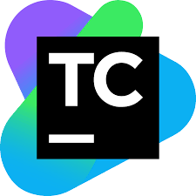

TC 8
Notes:
Note: Can be thought of as the ‘conveyor belt’ part of your software deployment single tool. Strings together your chosen tools and then runs them for you.
You are already familiar with one of them – Travis [click for it to appear]
There are also many others –
Codeship
Gitlab
CircleCI
Bamboo
TeamCity
Jenkins

Slide 23
TC 8
Pipelines
Notes:
The industry standard term for this conveyor belt is a 'pipeline'.
The idea is you shove source code in one end and out pops the finished product at the other.
We still prefer the conveyor belt idea ;)
We typically see pipelines referred to as part of Continuous Integration.
At its most basic, this is simply the practice of frequently merging code changes into a master branch.
Pipelines are often triggered on every committed code change.
We are going to build on of these pipelines in our bootcamp.

Slide 24

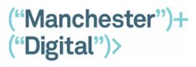
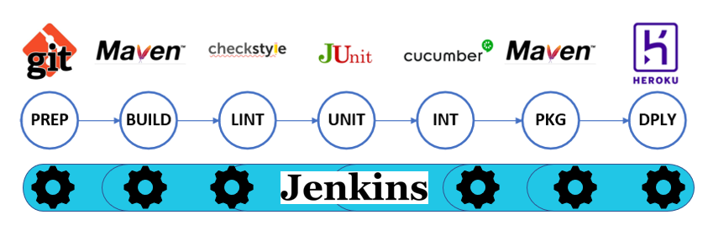
Bootcamp Pipeline
Notes:
Here is a sneak preview of what we will build over the next two days!
We've picked a best-practice approach for building, testing and deploying a web application onto a cloud server.
You are going to build each stage in the pipeline in the exercises that are coming up.
Note that this is a simplified version of how these tools would be combined –
Several activities that we will be doing would be run in one stage rather than separated out
We've written Maven tasks to do the heavy lifting; Jenkins only needs to call out the right things
It's a Java project as that's the most common language here; but don’t worry – the exercises do not need Java knowledge.

Slide 25


Notes:
I love this slide ;)
One thing you will learn in your jobs is that
Selecting, configuring and managing these tool chains is complex and demanding:
→ The devil is in the details – therefore also the money!
Professional platform engineers are well-paid to address the complexity of managing these tool chains.

Slide 26
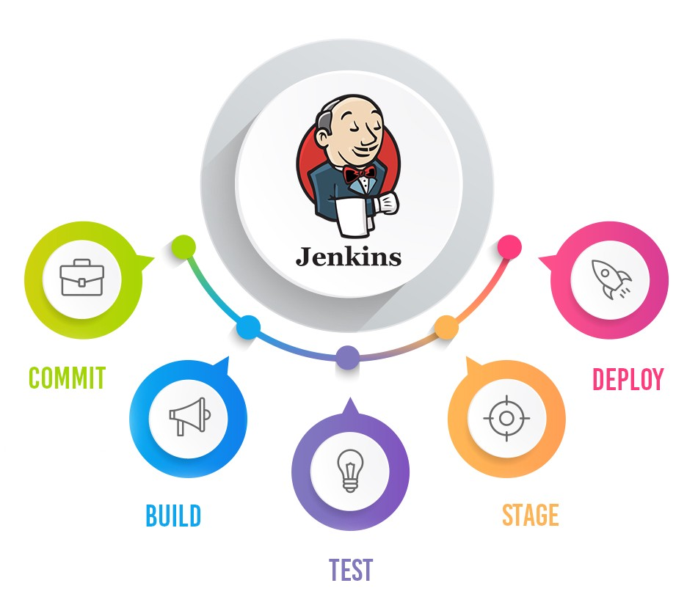

Notes:
The platform we will use in this bootcamp is Jenkins.
Quick shout out:
* Anybody here using Jenkins?
* What else do you use at work?
Jenkins is the industry leader for now – can orchestrate your full toolchain
[Next slide - discusses what it is]

Slide 27
What is Jenkins?
It's an automation engine
It sequences build tools
It produces a graphical view of pipelines
Includes popular build tools, built-in
1000+ plugins available
Zero cost. Open source. Established 2011.
Notes:
What is Jenkins?
Firstly, it's a piece of free, open source software.
It's job is to sequence all the build tools required in your pipeline.
It is the most common pipeline tool we see at BJSS. We recommend it for all our projects at present.
What's good about it is that it is easy to configure – and the many plugins allow it work with many different tech stacks.

Slide 28
Pipelines are defined by Scripts
You can create a pipeline using the graphical plugin ‘Blue Ocean’
Professionals use code:
'Infrastructure as Code'
Use source control to store, merge, rollback
Duplicate it for scaling
Jenkins provides a pipeline script editor.
Scripts use Groovy
Notes:
Because each project has its own unique set of build steps, each Jenkins pipeline will be different.
You can use a graphical plugin to build pipeline – the "Blue Ocean" plugin is great.
But professionals use code to define the pipeline.
It gives us several advantages:
* Infrastructure as Code – for repeatability
* Use source control to store, merge, roll back
Jenkins pipeline scripts use Groovy as their language.
It's really easy to grasp – especially with how little of it is actually needed.
We'll pick up enough Groovy as we go along.

Slide 29

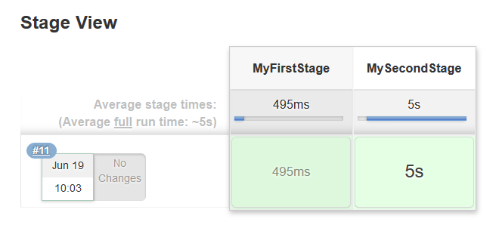
Structure of a Jenkins Groovy Script:
What it builds in Jenkins:
node{
stage(‘MyFirstStage’) {
…..do stuff in your stage….
}
stage(‘MySecondStage’) {
…..do stuff in your stage….
}
}
Notes:
So, let's take a quick look at the 'Hello World' of Jenkins pipeline scripts.
You'll see that the whole pipeline definition is contained within a 'node' keyword.
A Jenkins node – at a very simple level – is something that can execute a pipeline script.
Jenkins can be set up with many nodes to run many pipelines in parallel.
You can see two stages in this script - our assembly line has two robots.
Notice that 'stage' keyword and that each stage has a distinct – meaningful - name.
When you run this script in Jenkins, you will be shown a graphical pipeline that goes green for success and red for failure.
SHOUTOUT:
* How many of you have giant TVs with pipeline views up where you work?

Slide 30
Exercise 1: Getting Started with Jenkins
We’ll be creating a new Jenkins project
We’ll set up an empty pipeline
Create a first stage called ‘Preparation’
We will use this to call Github and access our sample code
Notes:
On to the first exercise.
And with that, I'm going to hand over to Marie who will be running our exercises today.

Slide 31
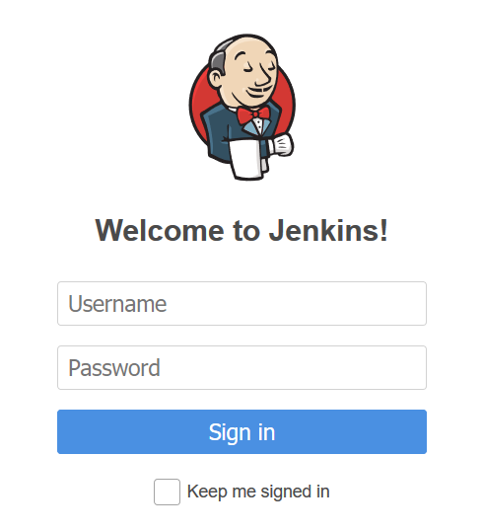
Exercise 1: Logging into Jenkins
It’s been set up for you – Jenkins is accessed and controlled through a web browser.
Go to the URL listed on your team’s exercise sheet.
Login to Jenkins
Username = jenkins
Password = DevApps2019
jenkins
DevApps2019

Slide 32
Exercise 1: Create a stage
To instruct Jenkins to access a Git repo – you use the following command inside your pipeline stage:-
git ‘URL placed here‘
The sample code for this exercise is located here, listed in this URL below: -
https://github.com/alanmellorbjss/inspiration-application.git
node{
stage(‘MyFirstStage’) {
…..do stuff in your stage….
}
stage(‘MySecondStage’) {
…..do stuff in your stage….
}
} //end of node

Slide 33
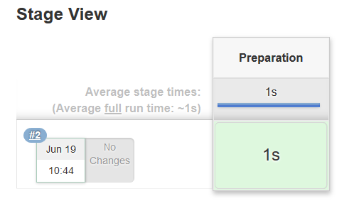
Exercise 1: Answer
node{
stage( ‘Preparation’ ) {
git ’https://github.com/alanmellorbjss/inspiration-application.git'
}
}
Notes:
Your pipeline script should now look like this.
This is enough to tell Jenkins to do a git clone and fetch the source code.
This ENSURES A FRESH BUILD – One old school problem was:
* old code on machine worked
* updated code in source control did not work
* the build accidentally used the old code: 'works on my machine'

Slide 34
Bootcamp Pipeline
Notes:
So we’ve completed the first stage of the pipeline

Slide 35

Tea Break

Slide 36
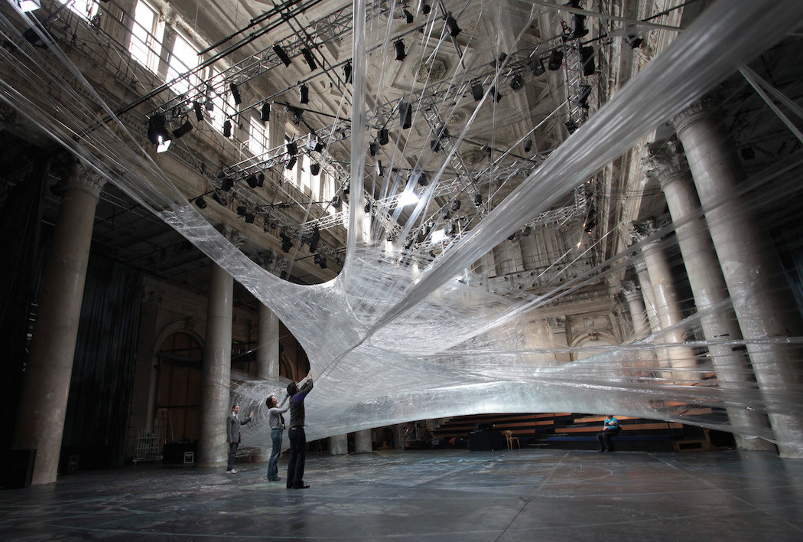
Dependencies and Packaging
TC 8
Notes:
Modern software is no longer a simple set of pages of code, but a sprawling, ever-changing web of items to manage.

Slide 37
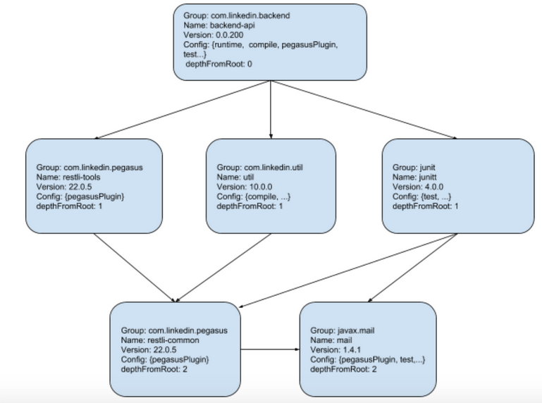
Components – what are they?
They can be many things:-
Software package
PERL module
Web service
Open source program
Separation of Concerns
Swappable
Notes:
By now you should be comfortable with the concept that good software design should involve grouping together functions into a self contained entity.
Confusingly this entity can go by many names.
You will hear "module, component, package, unit“ being talked about
When we talk about components, we mean a reasonably large scale code structure within an application.
It has its own well defined interface
Think of a component as; "anything that could be swapped for a different version"
The individual components can change while 'decoupled' from the main system: - the classic example is a driver for a printer or display
https://en.wikipedia.org/wiki/Component-based_software_engineering

Slide 38

Why use components?
Software re-use
Accommodate different rates of change
Easier collaboration
Maintenance as you scale up
Notes:
Component-based design encourages a host of benefits
Software reuse
Different rates of change → slow changing components vs fast ones (example: stored data changes more slowly than business logic)
Easier collaboration for large teams --->ownership of components
Maintenance as you scale: "Can seem like a lot of hassle for small projects, but small projects can evolve into large ones over time
Most companies have that huge half-million-line monster that nobody can change anymore.
Modern software systems will be made up of many different components.
You need to pick the right versions of each when building your system

Slide 39
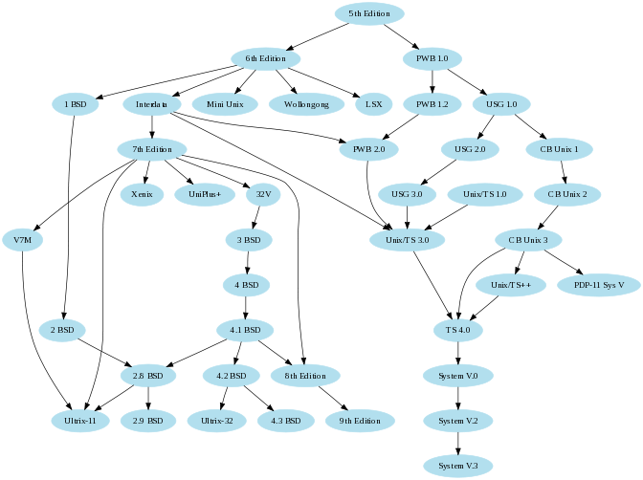
Dependencies
Whenever one piece of software depends on another to build or run you have a dependency.
There are Build time dependencies and Run Time dependencies
Notes:
Separation of concerns into components means you now have a host of dependencies.
Whenever one piece of software depends on another to build or run you have a dependency.
Most software applications have as a minimum - a dependency on their host operating environment
EG: Java --> JVM
.NET --> CLR
C --> C standard library
There’s an added complication – you may need different dependencies depending on where you are on your assembly line towards deployment!
Build time dependencies → Unit test frameworks, Acceptance test frameworks ----chuck these away once code ‘passes’ the test stage of assembly line
Run time dependencies → UI libraries, DLLs --→ what is in your zip file.
This is a historical problem: → ANT and NMAKE left the developer to download and add dependencies manually

Slide 40
Dependency Hell
In the early days this could bring about "Dependency Hell" where you could get :
conflicting dependencies (same program needs different versions)
missing dependencies
long chains
Notes:
Sub Sub libraries could violate security
--example
look for a real world example of a forgotten dependency biting you on the ass

Slide 41

Dependency diagrams
All components are placed on a circle and if they have a dependency you will draw a line between these components.
With enough connections, or even having to resort to a sphere to map them all, you are likely to be looking at what is known as
‘Deathstar diagrams’
Quite handy for demonstrating to non-technical folk just how ‘big’ the system you are working on is (and how hard your job is).
Notes:
If you map your components in a circle you can trace out dependencies as lines between them.
Gives you a way of visualising complexity
Useful for talking to non-technical people about code complexity (aka your manager)
Can scale this idea up – microservices mapped over a sphere for a whole corporate system:
Leads us to next slide…….

Slide 42
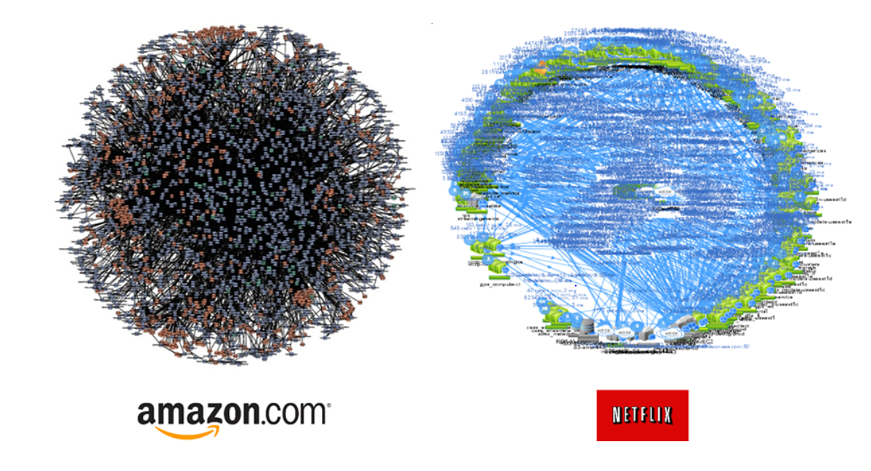
Notes:
Just for shock value – the microservices and their dependencies in two major corporate sites

Slide 43
Packaging
Packages collect multiple data files together into a single archive for easier portability and storage, or compression.
Simplest form are the installation zip files. The binaries included are pre-compiled according to defaults the developer has chosen.
They also contain metadata: -
Software name, purpose
Software version number
List of dependencies required for it to run properly
Notes:
Recap – we have a software system made up of components – and these components have dependencies on each other.
What gets packaged: source files, html files, graphics
All this information needs to be collected together and updated together when we deploy a change to the software system
This is called packaging the code. Basically a Compressed (zip) file with what you need.
You will already be familiar with common extensions for different environments:
In Windows a component is normally packaged as a DLL
In .NET assembly
In Unix --> a SO file
In Java --> JAR file JAR stands for Java ARchive
Early days we had package managers – with the widespread adoption of open source software, often our own applications depend on those written by others.
It is not trivial to manage all these dependencies which is where dependency managers come in. These are essential for Continuous Integration.
Thin Jars vs Fat Jars – but this was only a partial solution to dependency issues: - if something changes elsewhere you have to go and update your local copy in your fat JAR.

Slide 44
A New Hope: – Dependency Managers
Why they are great
What they do
What they don’t solve

Slide 45




There are many!
Old one - Ant
Most common: -
Maven
Gradle
Bundler
NPM
Notes:
Check if the image above is correct. Take off wordpress / meteor
Can we get the history slide working → long roll through Maven to dep https://devopedia.org/dependency-manager
Can we jump to this page on web????
Originally we had ANT (2000)
Ones you’ll come across most frequently:
Maven → from 2002 for Java projects --- uses XML
Gradle →2009 Java, including Android --- improves on Maven, uses Groovy instead of XML
Bundler → 2009 Ruby
NPM → 2011 NodeJS/Java Script
NuGET → for .NET

Slide 46
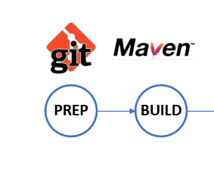
The Dependency Manager in our Bootcamp Pipeline
Notes:
This brings us to the next stage in our automated pipeline – the Dependency Manager.
We have been using MAVEN in our pipeline.
Maven is not just a dependency manager – it is known as a build management tool for Java projects.
It can:-
Build a project from java source files – without the need for scripting
Integrates into repos like github, integrates with CI systems like Jenkins
Simplifies the addition of dependencies
Prvides helpful reports, dependency list, unti test reports
all IDEs nowadays understand and support Maven (IntelliJ, Eclipse, and NetBeans).

Slide 47
Maven as a Dependency Manager
Dependencies in particular:
Manages your dependencies for you
Solves some of the dependency complexity by maintain a central repository of open source libraries
Provides standardisation
Notes:
For the sake of clarity in this bootcamp
Maven’s repo is for speed – it downloads the dependencies locally so you are not cha
Maven has a website Maven Central where you get your open source libraries
Your
Plugins – large number available, see https://maven.apache.org/plugins/
Only discuss the basic plugins we will use in our pipeline for simplicity’s sake.

Slide 48
Exercise 2 – Adding in Maven and Compiling
Here we will be:
Adding a stage called ‘Build’
Ensuring we have the Maven plugin within Jenkins
Calling Maven within our stage to compile the code
Checking our build console to see the dependency map

Slide 49
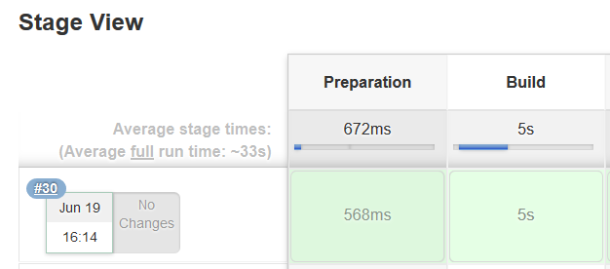
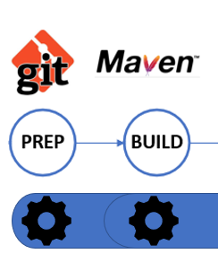
Exercise 2: Answer
node {
def mvnHome
stage('Preparation') {
// Get some code from a GitHub repository
git 'https://github.com/alanmellorbjss/inspiration-application.git'
// Setup mvnHome to point to the Maven tool.
mvnHome = tool 'M3'
} //end Preparation stage
stage('Build') {
sh "'${mvnHome}/bin/mvn' compile"
} //end Build stage
} //end of pipeline

Slide 50
Bootcamp Pipeline
Notes:
So we’ve completed the first two stages of the pipeline

Slide 51
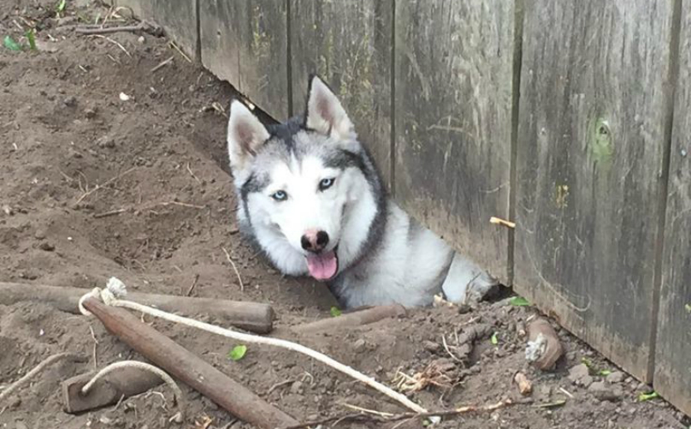
Lunch
Products are never released they merely escape.

